Slide 1
MANAGEMENT INFORMATION SYSTEMS
Chapter 8: Securing Information Systems

Slide 2
Recap of Chapter 7
Describe key components of telecommunications networks.
Identify major Internet services that support business communication.
Discuss how the web operates and how firms use it for marketing and collaboration.
Examine how emerging Internet and web technologies influence business strategy.

Slide 3
Information System Vulnerabilities

Slide 4
Understanding System Vulnerability
Imagine connecting a computer to the Internet with no firewall or anti-malware protection. Within seconds, attackers could disable the device, destroy data, or steal customer payment information.
For a business, such downtime interrupts sales, supply orders, and customer communication.
Modern firms must treat security and control as operational priorities.
Security: Policies, procedures, and technical measures that prevent unauthorized access, alteration, theft, or physical damage.
Controls: Methods and organizational procedures that safeguard assets, ensure record accuracy, and enforce management standards.

Slide 5
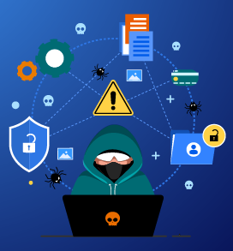
Why Systems Are Vulnerable: An Overview
Business systems connect through local, regional, and global networks. Each connection creates a potential entry point for misuse or attack.
Threats arise from technical, organizational, and environmental weaknesses, often worsened by poor management oversight.
A threat actor is any individual or group seeking to exploit a vulnerability to cause harm.
Common Threats: Unauthorized access, data alteration, theft, vandalism, or service disruption.

Slide 6
Why Systems Are Vulnerable: Part 1
Technical and Human Weaknesses
Users at the client layer can accidentally introduce errors or malicious software.
Data traveling across networks can be intercepted or modified during transmission.
Servers are vulnerable to intrusion, denial-of-service attacks, and malware insertion.
Even electromagnetic interference can disrupt network operations.
Threat actors may use compromised servers to reach backend databases and exfiltrate confidential information.
Hardware and Software Failures
Systems malfunction when components fail or are misconfigured.
Hardware can break down through misuse, overheating, or deliberate damage.
Software may fail due to programming errors, improper installation, or unauthorized changes.
Environmental hazards such as outages, floods, or fires interrupt service and destroy storage devices.
Reliable backup power and disaster-recovery plans are essential for business continuity.

Slide 7
Why Systems Are Vulnerable: Part 2
Organizational and Partnering Risks
Outsourcing or offshoring increases exposure because partners may store sensitive information outside direct corporate control.
Weak safeguards among partners can lead to data loss, theft, or privacy violations.
Vendor networks and third-party cloud services expand the potential attack surface.
Firms must require compliance with shared security standards in contracts and audits.
Mobile Device Vulnerabilities
Portability makes smartphones and tablets easy to lose or steal.
These devices contain sensitive data such as sales figures, contact lists, and emails.
Mobile operating systems share many of the same weaknesses as other Internet-connected platforms.
Attackers can use compromised mobile devices to access internal corporate systems.
Mobile Device Management (MDM) software and remote-wipe capabilities reduce exposure.

Slide 8
Why Systems Are Vulnerable: Part 3
Internet Vulnerabilities
Public networks such as the Internet are inherently open and accessible to anyone.
When corporate systems connect to the Internet, exposure multiplies.
Email, instant messaging, and peer-to-peer (P2P) file sharing increase risk:
Email attachments and links may install malware or capture credentials.
Employees might send confidential data to unauthorized recipients.
Illegal P2P downloads can install malicious software or leak personal data.
Management must set strict policies on network use and data handling.
Sniffers and Eavesdropping
A sniffer is software that monitors network traffic.
When used properly, sniffers help diagnose problems and detect suspicious activity.
When misused, they allow attackers to steal proprietary information such as passwords or emails.
Because sniffers are difficult to detect, encrypted network protocols are vital.

Slide 9
Why Systems Are Vulnerable: Part 4
Wireless Security Challenges
Bluetooth and Wi-Fi networks are vulnerable to eavesdropping.
The openness that enables easy connection also exposes access points.
Service Set Identifiers (SSIDs) broadcast network names repeatedly and can be captured by intruders.
War Driving: Attackers park near buildings to intercept traffic from unprotected networks.
Rogue Access Points: Devices set up by attackers to mimic legitimate networks, capturing user credentials and data.
Strong encryption (WPA3), hidden SSIDs, and physical access controls reduce risk.
5G and Emerging Threats
Cellular systems are more secure than Wi-Fi, but 5G expands the number of connected devices and vendors.
The complexity of 5G architecture widens the potential attack surface.
Interconnected sensors, vehicles, and industrial equipment require continuous monitoring.
Security teams must coordinate across suppliers to manage software updates and encryption keys.

Slide 10
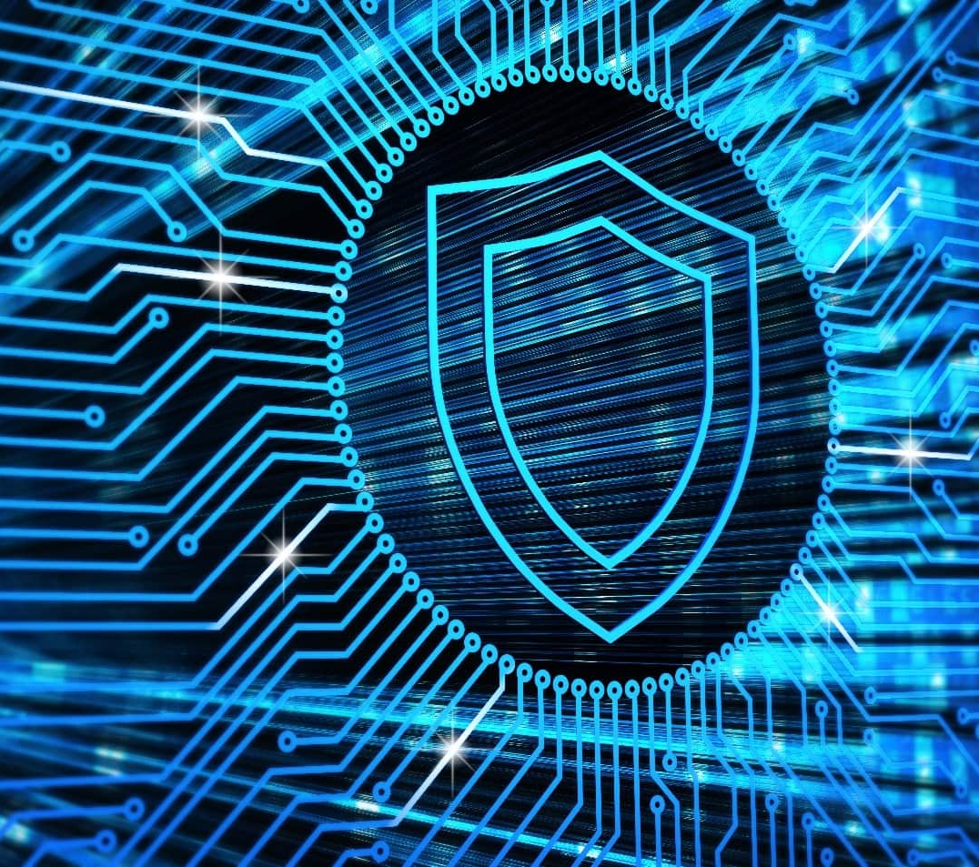
System Vulnerability
Every connection creates potential exposure.
Vulnerabilities arise from hardware, software, human error, and environmental factors.
External partners, mobile devices, and wireless networks extend risk beyond physical boundaries.
A layered defense of policies, training, encryption, and monitoring protects organizational data.

Slide 11
Malware Threats

Slide 12
Understanding Malware
Malware (malicious software) includes viruses, worms, Trojan horses, ransomware, bots, and potentially unwanted programs (PUPs).
Malware spreads through downloaded files, infected email attachments, compromised ads, or instant messages.
Drive-by Downloads: Code installed on a device without user knowledge while browsing a compromised website.
Malvertising: Malware inserted into legitimate online advertising networks such as Google Ads.
Malware can also enter through infected USB drives or mobile devices.

Slide 13
Types of Malware
Viruses
Rogue programs that attach to other files or software and execute without user consent.
Usually deliver a payload ranging from harmless graphics to destruction of data or system files.
Spreads through human action: Sharing infected attachments or copying files.
Defense: Real-time antivirus scanning, attachment filtering, and user education.
Worms
Self-replicating programs that spread automatically over networks without needing a host file.
Consume bandwidth, delete files, and may disable operating systems.
Rely less on human behavior, spreading rapidly from one device to another.
Defense: Timely software updates, network segmentation, and intrusion detection systems.

Slide 14
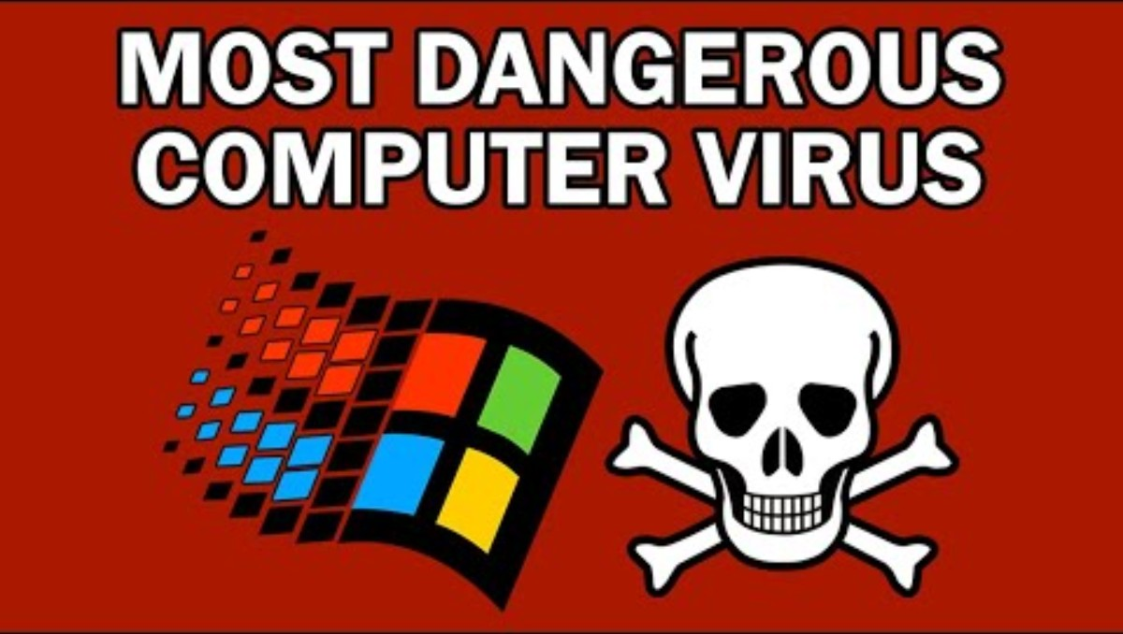
NationSquid (2020, April 3). The World's Worst Computer Virus: The I Love You Virus (Demonstration) [Video]. YouTube. https://youtu.be/NZDiQczOsdc?si=vCwYDWPq_B4RdNbs

Slide 15
Types of Malware
Trojan Horses
Programs that appear legitimate but contain hidden malicious functions.
Do not self-replicate but often act as delivery vehicles for other malware.
Named after the deceptive strategy of the Trojan War.
Defense: Download software only from trusted sources, and use endpoint protection.
Ransomware
Locks users out of their data and demands payment for release, and is increasingly common on both desktops and mobile devices.
The “ransomware-as-a-service” model allows affiliates to rent attack tools from developers, splitting profits.
Ransom attacks rose ≈ 70 % in 2023, with average payments climbing yearly.
Defense: Frequent offline backups, network isolation, and employee training to resist phishing.

Slide 16
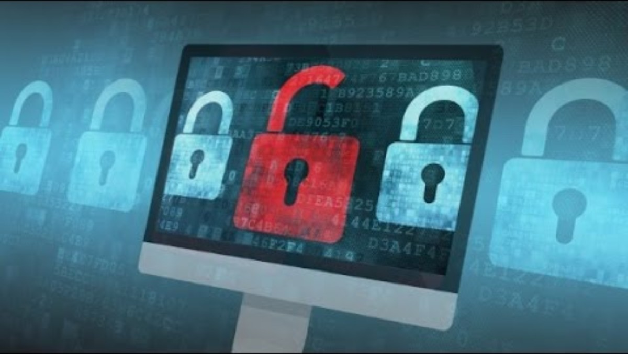
CNN (2017, May 12). Ransomware 'WannaCry' attack explained [Video]. YouTube. https://youtu.be/cZ543_0bjbw?si=gK45Y0vQ-4G3f0ME

Slide 17
Types of Malware
Bots and Botnets
Bot: Malware that allows external control of an infected device.
Botnet: A network of compromised computers controlled by attackers.
Used to launch DDoS attacks, send spam, or steal credentials.
Defense: Block command-and-control traffic, monitor unusual outbound activity.
Potentially Unwanted Programs (PUP)
Software that installs without full consent, including adware, spyware, and rogue utilities.
Keyloggers record every keystroke to capture passwords and credit-card numbers.
Other PUPs hijack browsers, redirect searches, or degrade performance.
Defense: Restrict administrative rights, scan regularly, and educate users about deceptive downloads.

Slide 18
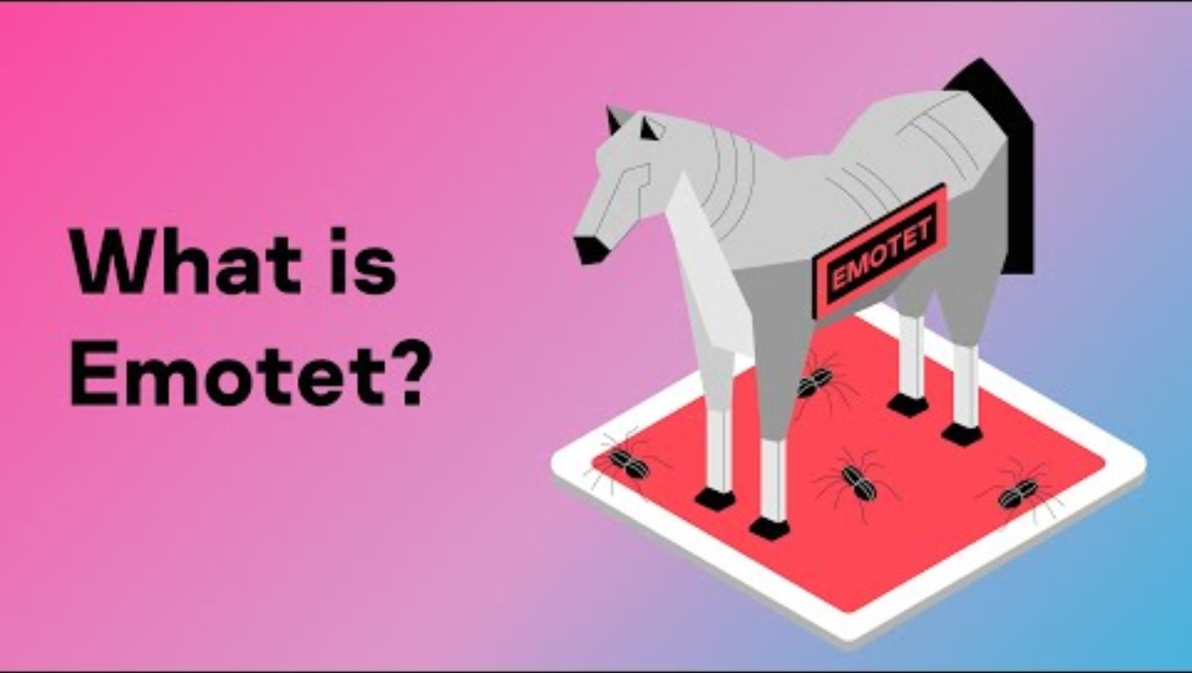
Kaspersky (2023, March 17). What is Emotet? [Video]. YouTube. https://youtu.be/oYQrIgx0wV4?si=2Aef0_2XqJTSY0-o

Slide 19
Types of Malware
Mobile Device Malware
Smartphones face the same threats as computers with added risks of constant connectivity.
2023 data shows > 80 % of organizations faced mobile-focused attacks (Verizon).
Enterprise Concern: Infected phones linked to corporate networks can exfiltrate internal data.
Social Networks and Emerging Platforms
Malware spreads rapidly through trusted social connections.
Users in virtual environments such as the metaverse face new risks:
Manipulated VR/AR hardware could cause physical harm.
Harassment and data privacy violations are growing concerns.
Security teams must extend monitoring to these new digital endpoints.

Slide 20
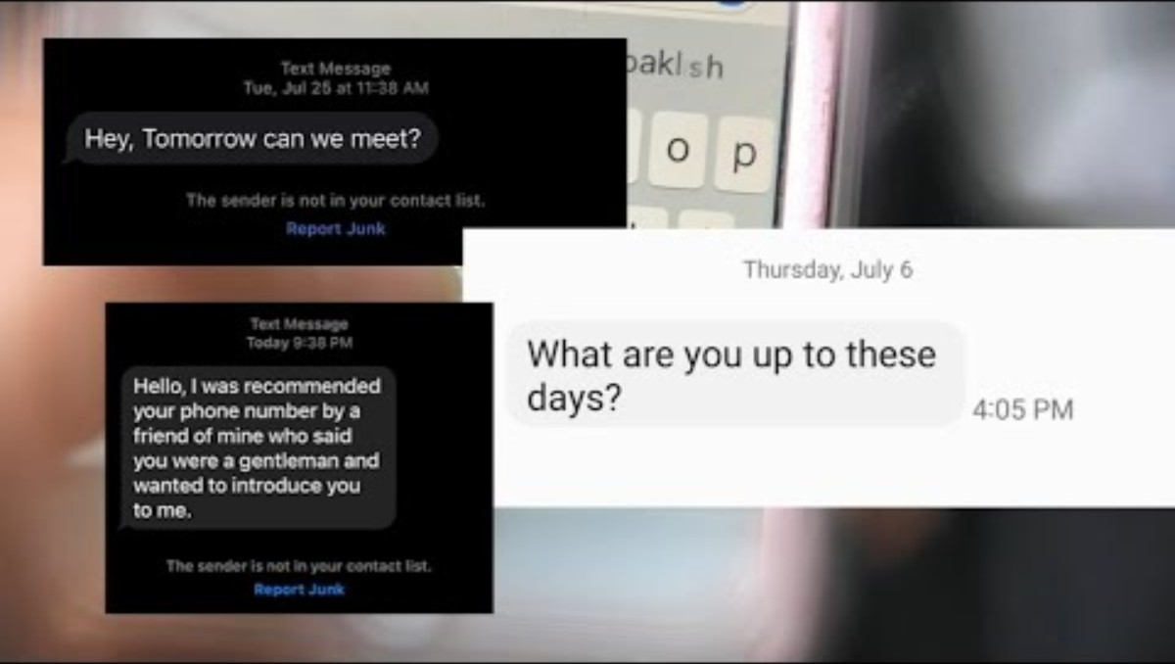
ABC 7 Chicago (2023, August 8). Scam texts from unknown numbers could infect your phone with malware [Video]. YouTube. https://youtu.be/hAtdD3XNVcs?si=Y8Ebym0fd3ZmPSeJ

Slide 21
Dangers Posted by
Threat Actors

Slide 22
Who Are Threat Actors?
Threat actors are individuals or groups seeking to exploit vulnerabilities to cause intentional harm.
Types include:
Cybercriminals: Pursue financial gain through theft, extortion, or fraud.
Nation-states and terrorist groups: Engage in espionage, sabotage, or ideological attacks.
Hackers: Explore or exploit systems for challenge or notoriety; some are hired as ethical hackers or bug-bounty participants.
Hacktivists: Act for political or social causes through disruption or defacement of websites.
Insiders: Employees or contractors who unintentionally or deliberately compromise systems.
Next, we describe the common tactics and methods these threat actors use.

Slide 23
Spoofing, Phishing, and Pharming
Spoofing: Disguising identity by faking email addresses or web links.
e.g., Fake online stores that mimic a real brand to steal customer data.
Phishing: Fake emails or sites impersonate legitimate companies to capture confidential information.
Targets: Social security numbers, credit card data, login credentials.
Spear Phishing: Customized message from a known or trusted source.
Business Email Compromise (BEC): Attackers impersonate executives authorized to transfer funds.
Generative AI tools are increasingly used to create convincing phishing messages.
Evil Twins: Fake Wi-Fi networks posing as legitimate hotspots.
Pharming: Redirects users to bogus websites even when the correct URL is entered.

Slide 24
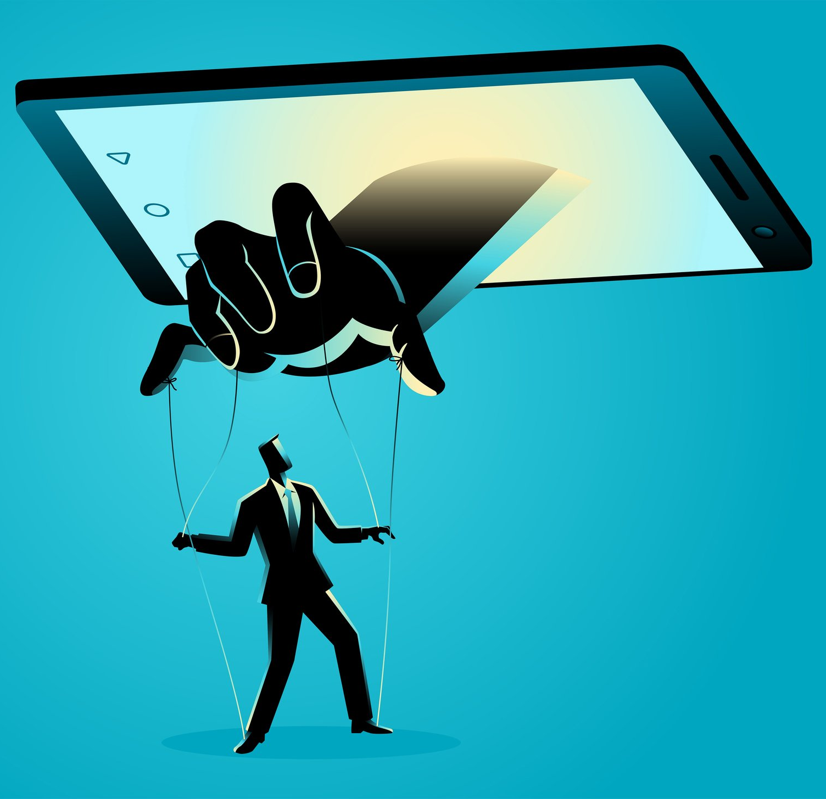
Social Engineering
Exploits human psychology rather than technical flaws.
Triggers curiosity, fear, or urgency to manipulate victims into revealing information or clicking links.
Effective prevention requires awareness training and verification policies.

Slide 25
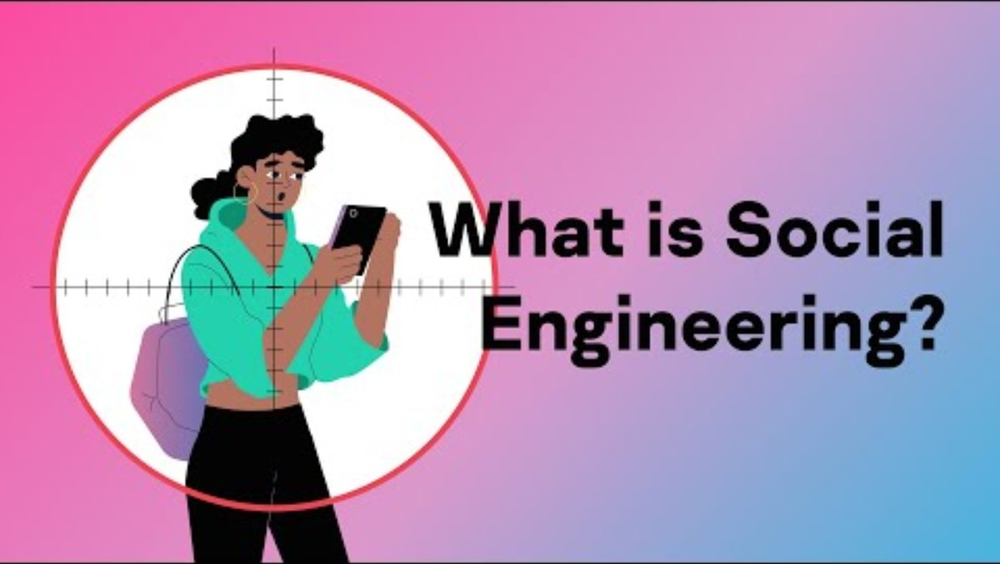
Kaspersky (2023, March 27). What is Social Engineering? [Video]. YouTube. https://youtu.be/uvKTMgWRPw4?si=_o5oTBEXoVF05pZf

Slide 26
LOTL and APT Attacks
Living off the Land (LOTL) attacks: Exploit legitimate system tools to perform malicious actions without installing new files.
Difficult to detect because they appear as normal operations.
Used to escalate privileges, steal data, or create hidden access points.
Advanced Persistent Threats (APT) attacks: Prolonged, strategic intrusions where attackers remain undetected for months.
Combine multiple tactics: infiltration, persistence, and data exfiltration.
Typically used by nation-states or organized criminal groups targeting high-value assets.

Slide 27
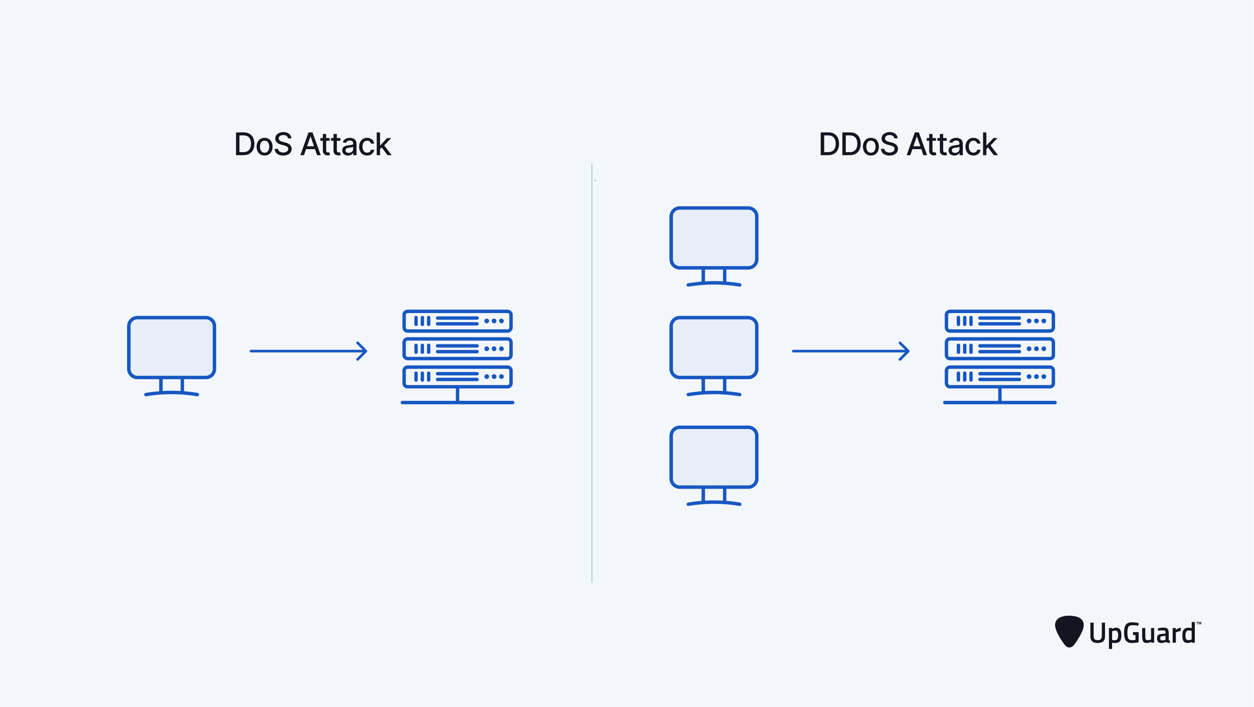
DoS and DDoS Attacks
Denial-of-Service (DoS) attack: Floods a server or network with requests to overload it and shut down service.
Distributed Denial-of-Service (DDoS) attack: Uses botnets to launch coordinated floods from many computers simultaneously.
Effects: Downtime, lost sales, and reputational damage.
Small and midsize firms are especially vulnerable due to limited resources.

Slide 28

FOX 5 New York (2018, January 3). How the Mirai Botnet Attack Is Linked to a Minecraft Stunt [Video]. YouTube. https://youtu.be/Xuy-zL13K1A?si=Rf9b6HSfKYvHV1H3

Slide 29
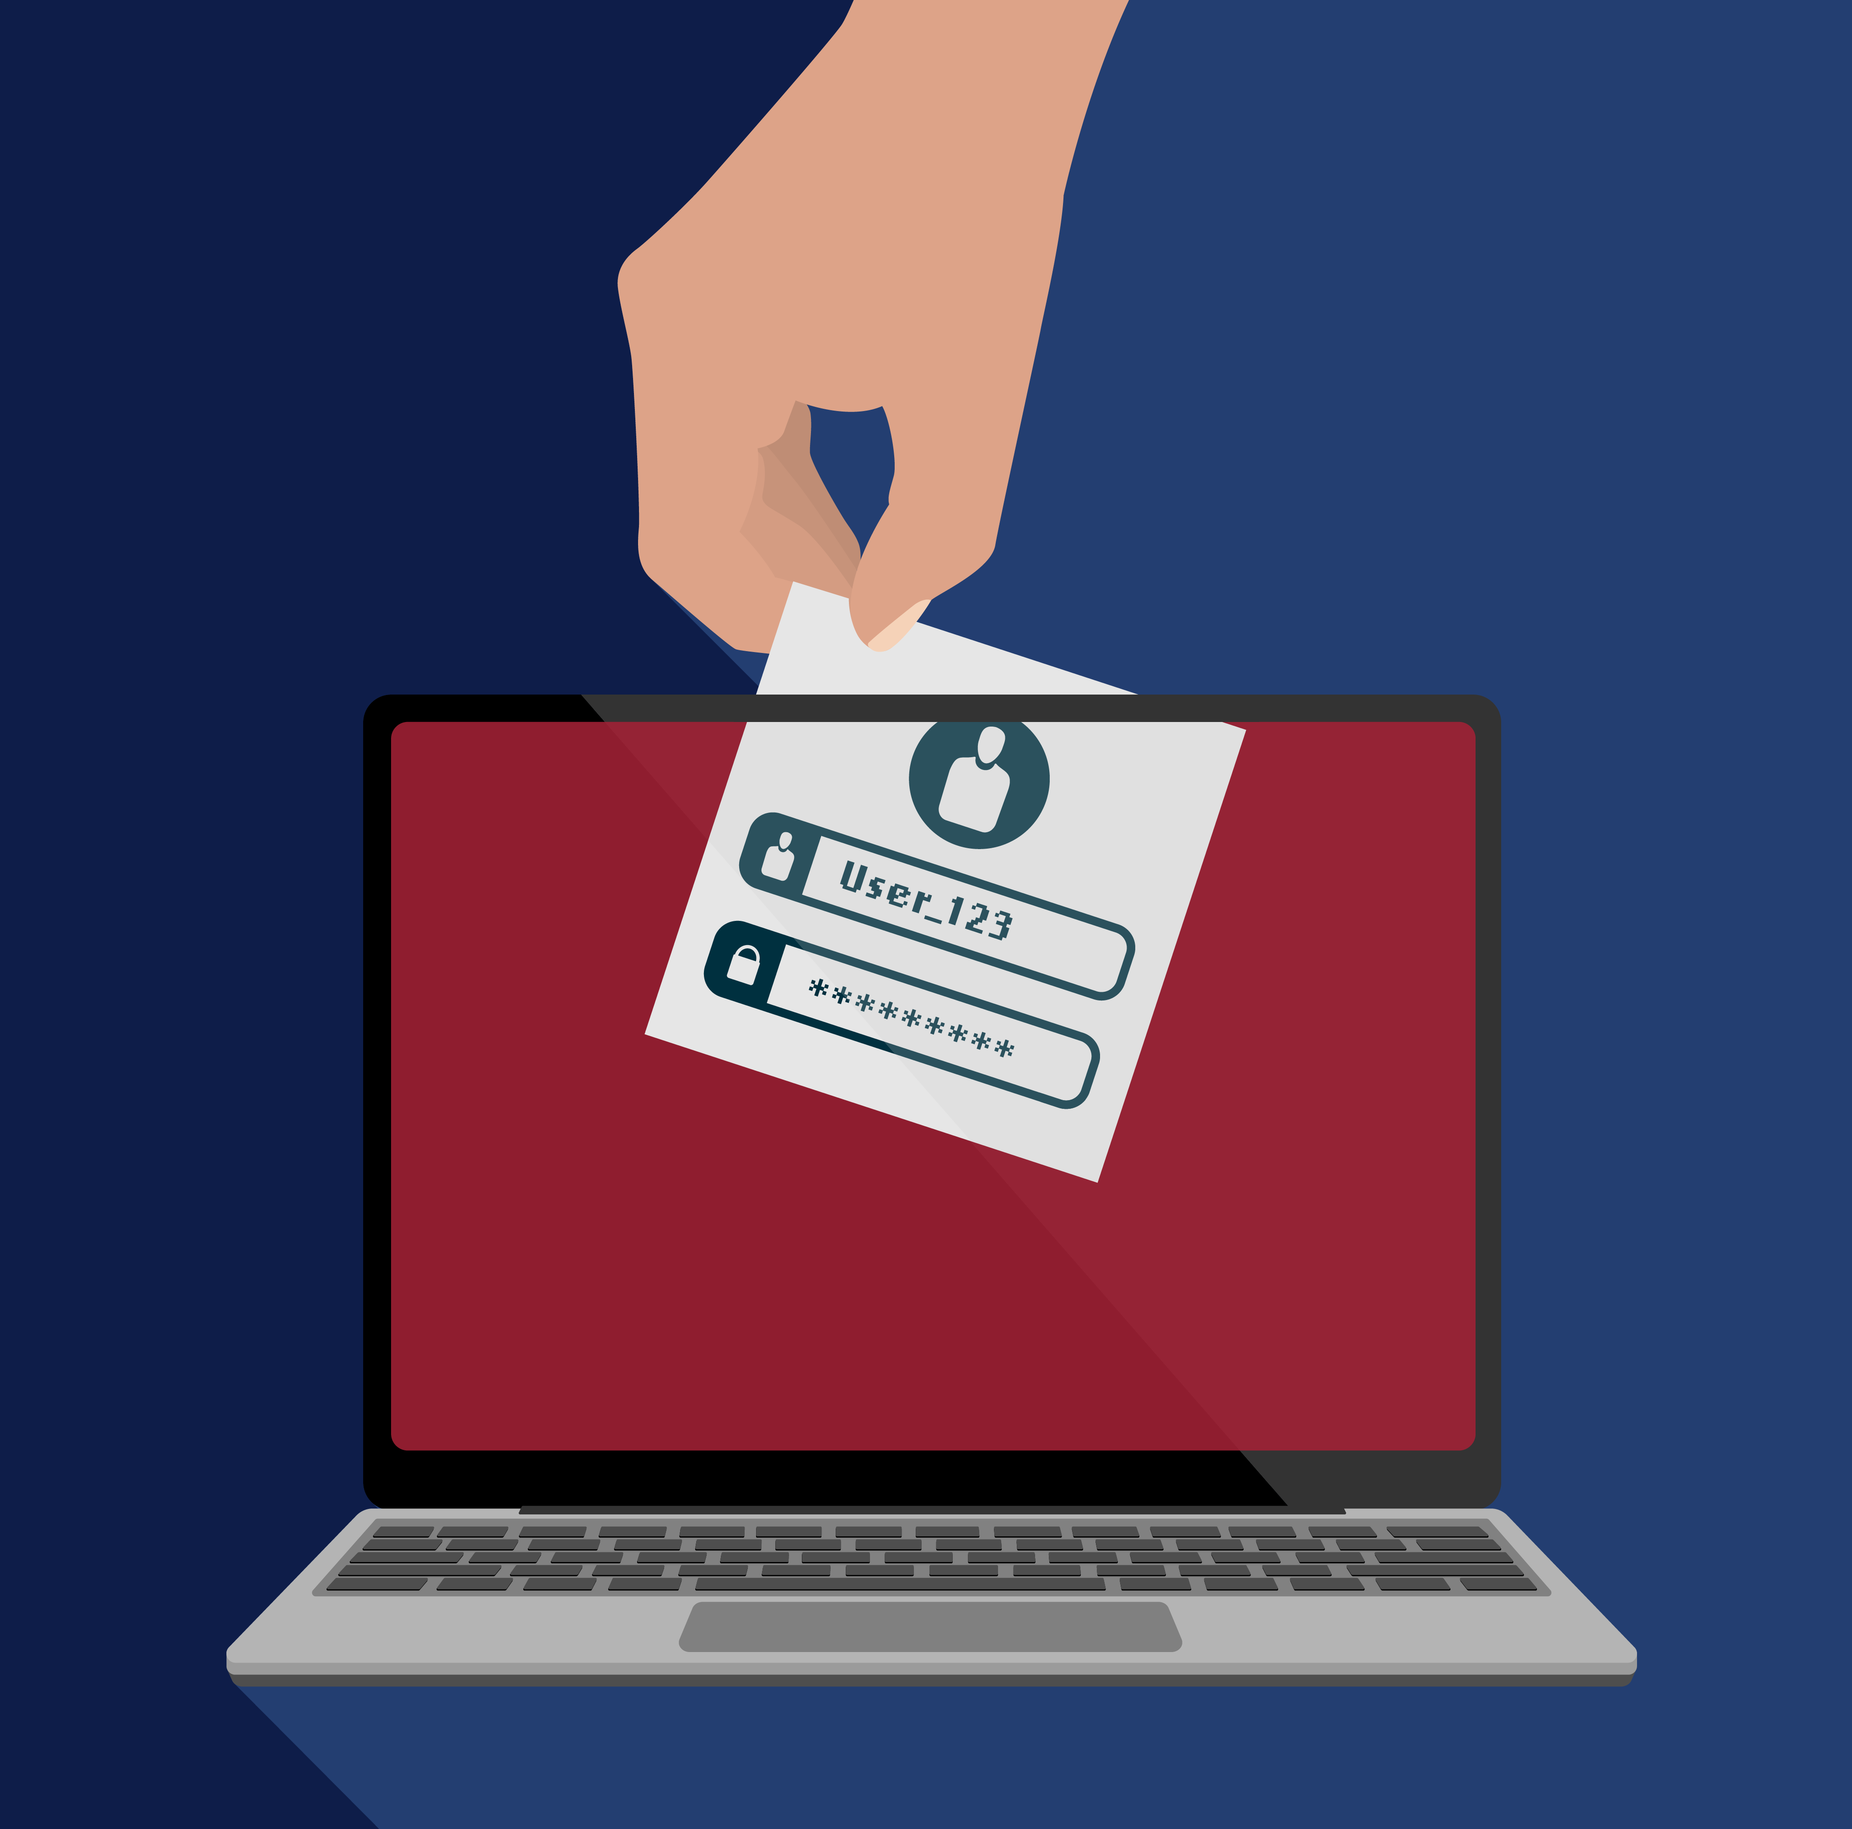
Data Breaches and Identity Theft
Data Breach: Loss of control over organizational data, often followed by credential-stuffing attacks using stolen logins.
Cost: Average global breach cost reached $4.45 million in 2023 (IBM Security).
Identity Theft: Using stolen personal information (e.g., SSNs or credit-card numbers) to impersonate victims.
Over 1 million identity-theft reports were filed with the FTC in 2023.

Slide 30

ABC News (2017, September 8). Equifax data breach could affect more than 140M Americans [Video]. YouTube. https://youtu.be/X2mbhfrdBhg?si=fAkKZj6Uo0z9ZTSK

Slide 31
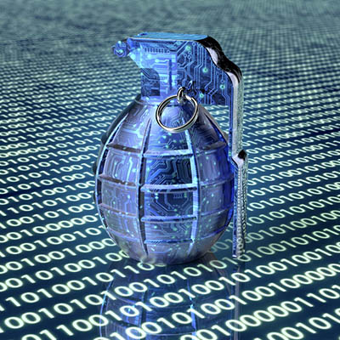
Cyberwarfare and Cyberterrorism
Cyberwarfare: State-sponsored digital conflict to disrupt another nation’s systems or infrastructure.
Cyberterrorism: Ideologically driven attacks by non-state actors.
Targets: Power grids, transportation, banking, and government databases.
Over 30 countries maintain offensive cyberattack capabilities.
U.S. Cyber Command oversees national defense of military networks.

Slide 32
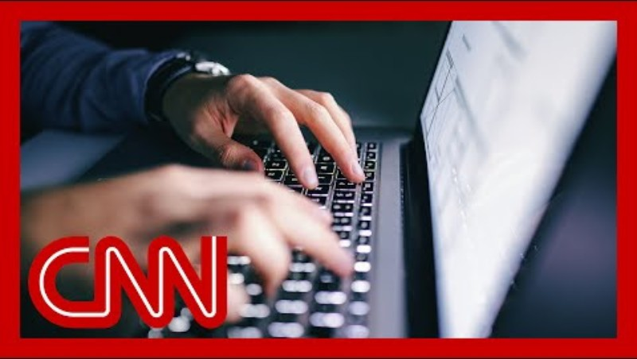
CNN (2024, November 24). Officials call China's cyberattack 'worst telecom hack' in US history [Video]. YouTube. https://youtu.be/aUVc2Vbzwg0?si=Q-qgYJByPGOjif4x

Slide 33

Internal Threats
Insider threats can be accidental or malicious.
Non-malicious insiders caused ≈ 75 % of incidents in 2023 (Ponemon Institute).
Malicious insiders cause fewer incidents but higher financial losses.
Common Issues: Weak passwords, sharing credentials, and falling for social-engineering tactics.
Mitigation: Access control, monitoring, and employee training.

Slide 34
Computer Crime and Cyberlaw
Computer Crime: Any violation of criminal law requiring knowledge of computer technology.
The Computer Fraud and Abuse Act (1986) criminalizes unauthorized system access.
Today, 156+ countries enforce cybercrime laws (UNCTAD 2024).
Global cybercrime costs were estimated at $9.5 trillion in 2024 and projected to exceed $15 trillion by 2029 (Cybersecurity Ventures).
Effective defense combines legal compliance, technical safeguards, and continuous user awareness.

Slide 35
Software Vulnerabilities

Slide 36
Software Vulnerabilities and Complexity
Software errors create constant risks to productivity, privacy, and safety.
Modern programs are large and complex, and they must be released quickly to meet market demand.
Even small programs can contain hundreds of decision paths, while enterprise systems have millions.
Complete testing is not possible because of the number of possible outcomes.
Dependability is proven only after long periods of operational use.

Slide 37
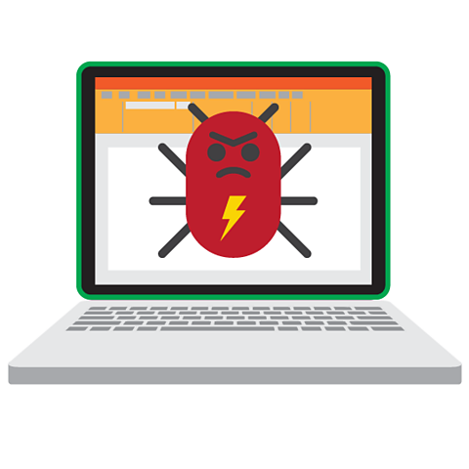
Hidden Bugs and Zero-Day Vulnerabilities
A bug is a defect or error in code that causes incorrect or unpredictable behavior.
A zero-day vulnerability is a flaw unknown to the software developer, leaving zero time to patch it before attackers take advantage of it.
Thousands of new vulnerabilities are reported each year.
Open-source software can be especially risky because many projects depend on volunteers who have limited resources to respond quickly.

Slide 38
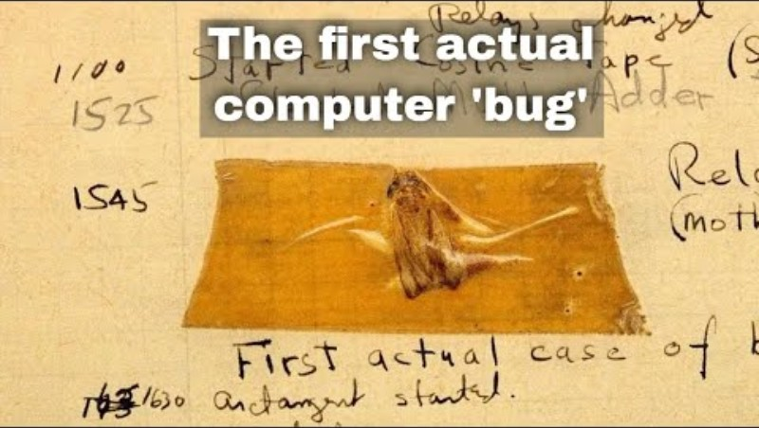
HistoryPod (2022, September 8). 9th September 1947: First computer ‘bug’ found in the Harvard Mark II electromechanical computer [Video]. YouTube. https://youtu.be/UPuTO9vg5gk?si=Qdb7yc2bIww1yZfS

Slide 39
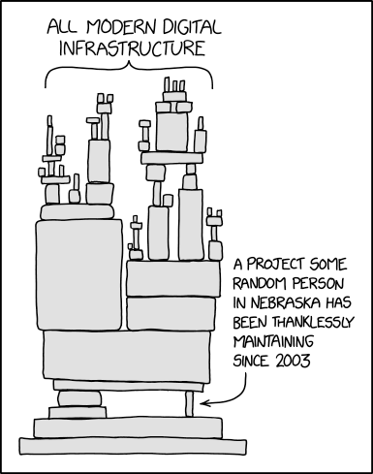
Open-Source Dependency Risks
The average application relies on more than 500 open-source components.
Each component can contain unknown vulnerabilities that put other systems at risk.
Security depends on how active and well-resourced the developer community is.
Organizations should keep an updated inventory of all open-source code, apply updates quickly, and monitor vulnerability databases.

Slide 40
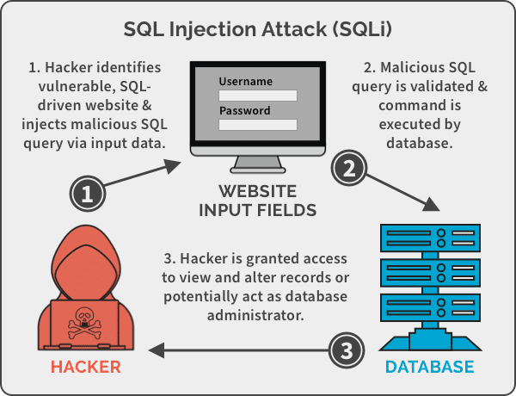
SQL Injection Attacks
These attacks occur when web applications fail to filter or validate user input.
Attackers send harmful SQL commands through fields such as login or order forms.
The commands can access or change confidential data, install malicious code, or compromise other systems.

Slide 41
New Threats: Software Supply Chain Attacks
In these attacks, threat actors compromise software while it is being developed, tested, or updated.
Malicious code can be inserted into trusted software before customers receive it.
The attack takes advantage of the trust that organizations place in updates or patches.
One breach of a vendor can lead to hundreds of client systems being exposed.
Common methods:
Corrupting tools that developers use to build software
Inserting harmful code into open-source repositories
Stealing or faking digital certificates to sign malicious updates

Slide 42
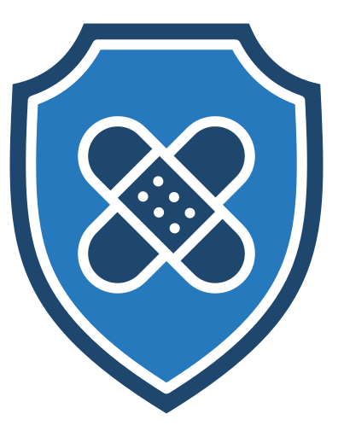
Prevention: Patch Management
A patch is a software update that repairs known flaws.
Patch management means tracking vulnerabilities, testing fixes, and installing them safely.
This process is difficult because companies must update many systems and devices.
There is little time between the discovery of a flaw and the release of malware that exploits it.
IT teams must balance the speed of patching with the need to test for stability and compatibility.

Slide 43
Defending Against Software Exploits
Apply secure software development practices and continuous security reviews.
Use automated tools to check for known vulnerabilities.
Verify digital signatures and authenticity before installing updates.
Establish change-management policies that document all system modifications.
Subscribe to trusted vulnerability-tracking services such as CVE or NIST NVD.

Slide 44
AI and Security Threats

Slide 45
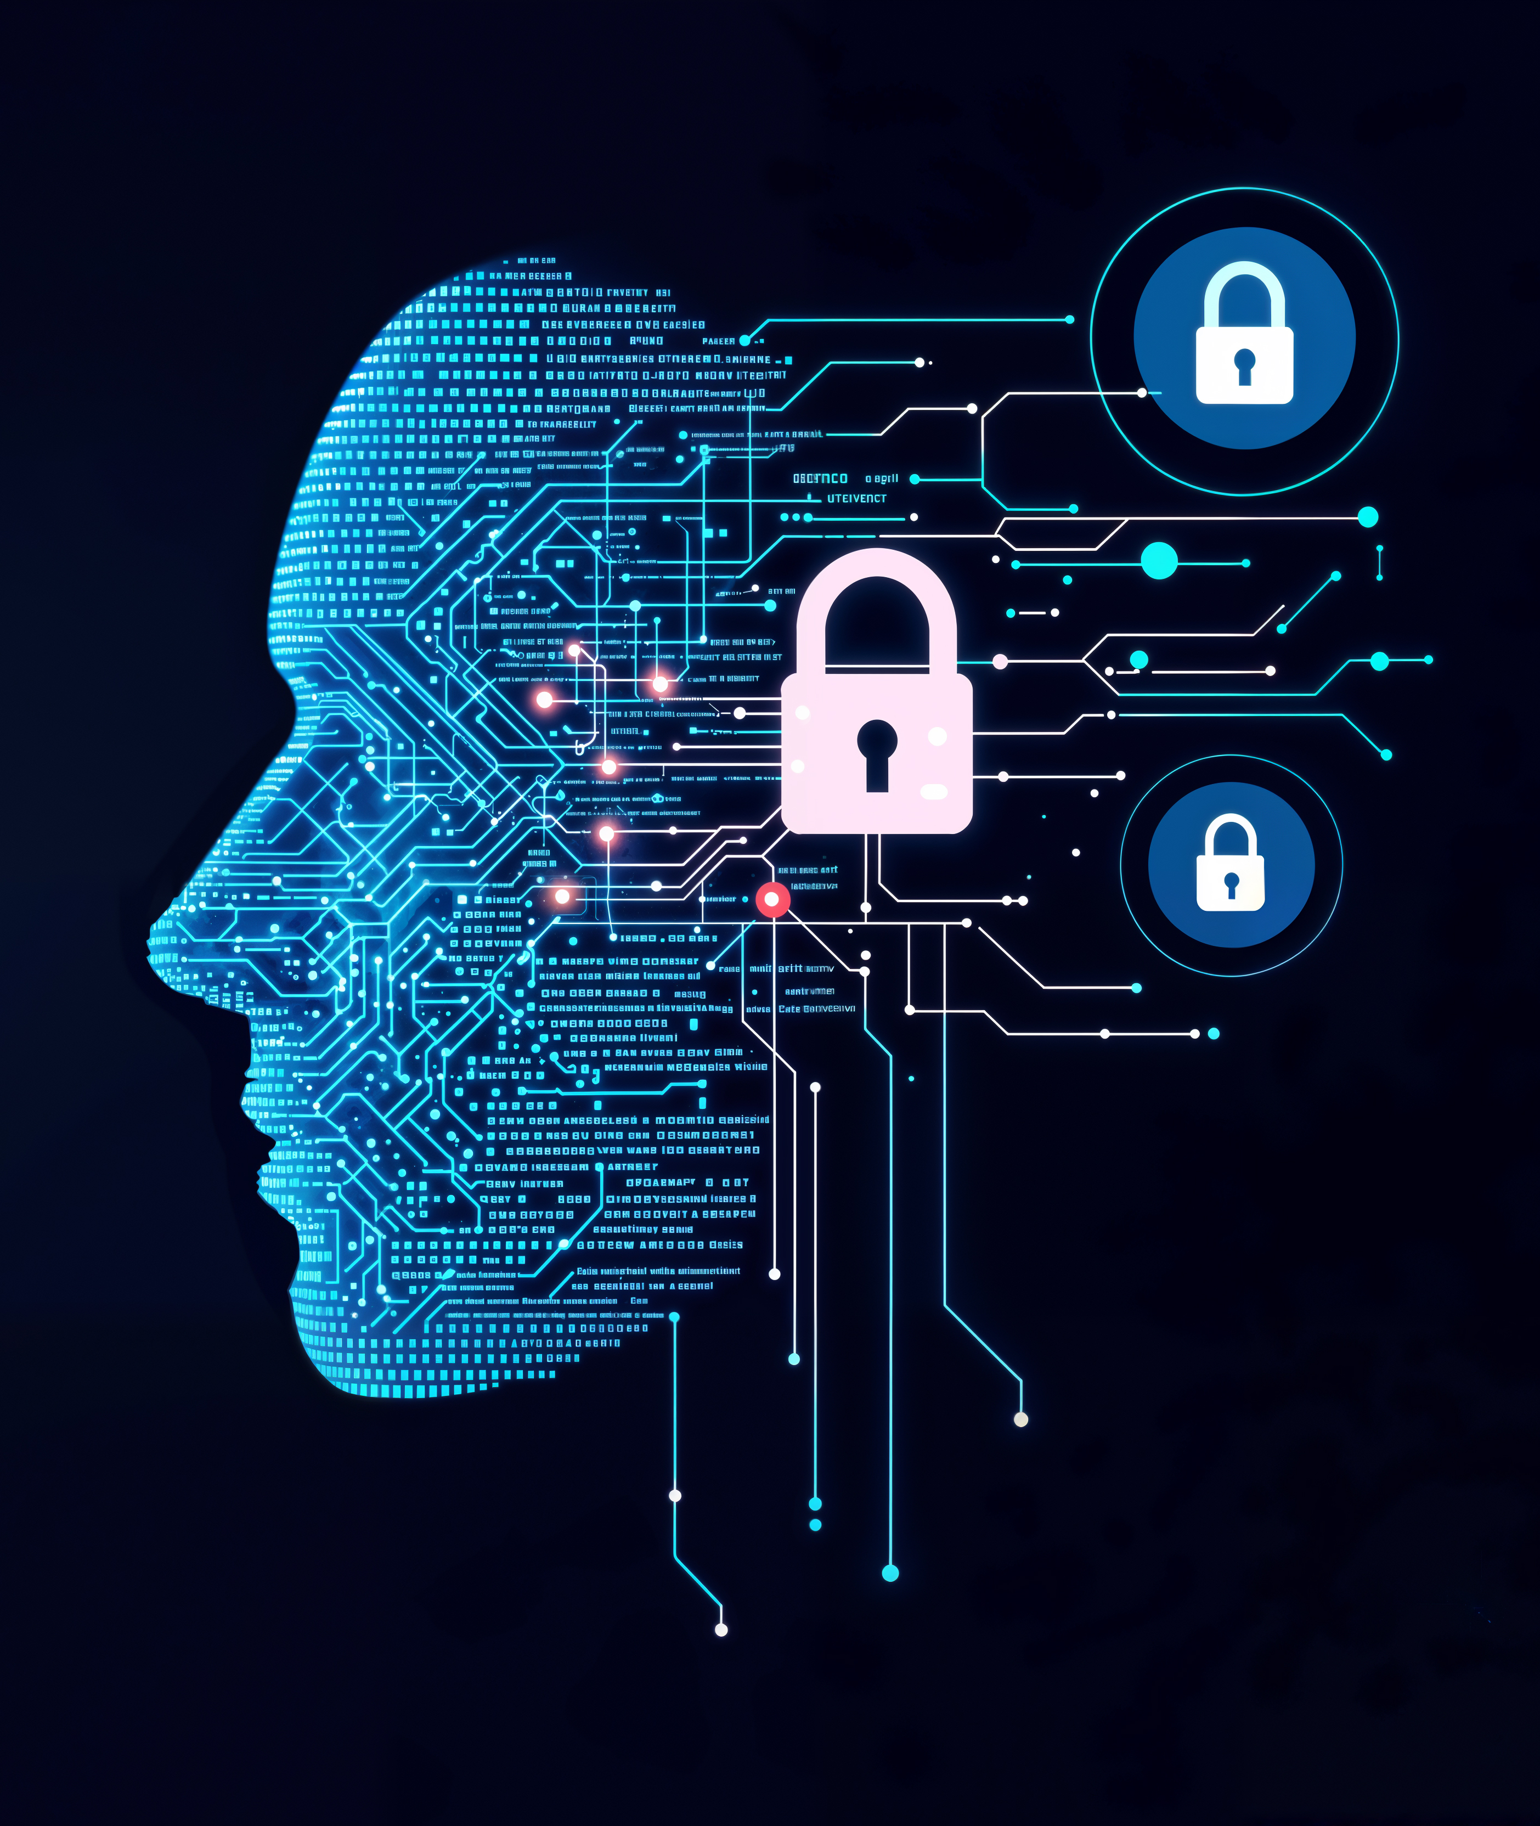
AI as a New Cybersecurity Challenge
Artificial intelligence offers major benefits for business efficiency and automation, yet it also introduces new risks.
Cybercriminals are already using AI to build faster and more complex attacks.
AI systems themselves can be manipulated to act in harmful ways.
Threats now include AI-generated phishing, deepfake content, and the misuse or subversion of large language models.

Slide 46
Phishing with AI
Traditional phishing messages often contain spelling errors or awkward language that reveal them as fake.
Security systems can detect repeated text patterns or reused templates in such emails.
Generative AI tools like WormGPT allow criminals to produce messages that look professional and unique.
AI can also collect personal details about a target to craft convincing spear-phishing or business-email-compromise (BEC) attacks.
Organizations must train users to question even well-written and polished messages.

Slide 47
Deepfakes and Synthetic Media
A deepfake is an image, video, or voice recording created by AI to imitate a real person.
These realistic fabrications can mislead people or bypass identity systems that rely on facial or voice recognition.
Deepfakes may be used for fraud, blackmail, or propaganda.
Modern tools can generate convincing fakes with very little data and minimal technical skill.
Firms should verify sources, use multi-factor identity checks, and monitor social media for false content involving executives or brands.

Slide 48

Hank Green (2025, October 7). Give me a single reason why Sora2 should exist. [Video]. YouTube. https://youtu.be/Vz0oQ0v0W10?si=AYeovkzElB-e7FYg

Slide 49
Subverting LLMs
Large Language Models (LLMs) are systems that generate human-like text after training on massive data sets.
Cybercriminals try to jailbreak or inject prompts that bypass built-in safety rules.
These prompt-injection attacks can make an LLM produce harmful code or reveal restricted information.
Researchers have shown that LLMs can be tricked into generating ransomware or exfiltration scripts.
Some models have been manipulated to disclose their own internal instructions and safeguards.

Slide 50
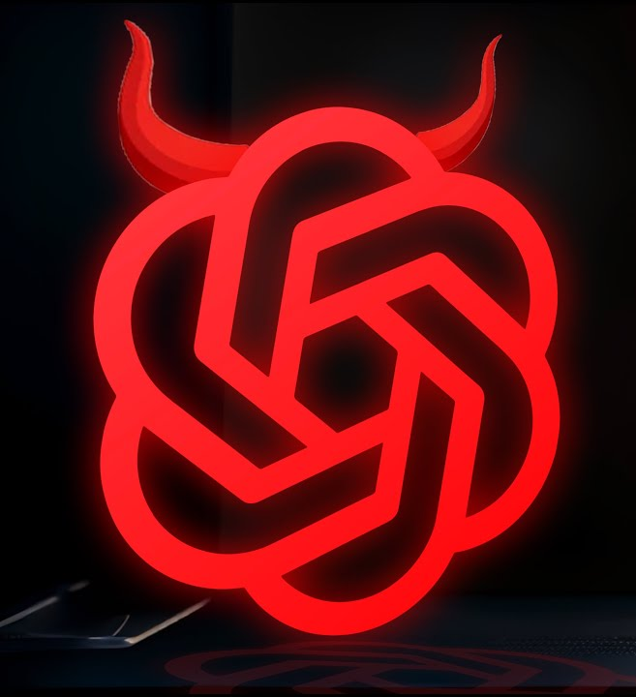
Malicious Generative AI Tools
Criminal developers are building AI systems without ethical limits.
WormGPT was created specifically for malicious tasks, focusing on malware-related data.
FraudGPT offers additional functions for scams and phishing.
DarkBART and DarkGemini are subscription-based tools that combine LLMs with dark-web services.
These systems make it easier for less-skilled attackers to create advanced threats.

Slide 51
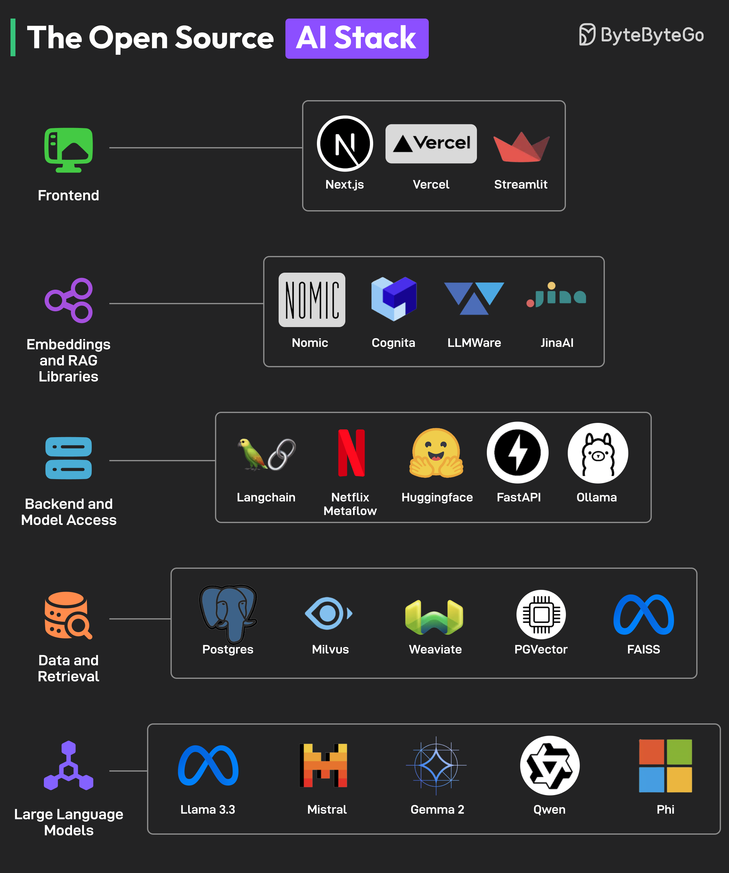
Open-Source AI Risks
Open-source AI models on public platforms can be downloaded, modified, and reused by anyone.
Some repositories now host hundreds of potentially malicious or unsafe models.
Attackers can retrain these models to remove safety constraints and create new attack platforms.
Firms that use open-source AI tools must evaluate each model’s provenance, maintain usage logs, and restrict access to development environments.

Slide 52
Value of Security and Control

Slide 53
Why Security and Control Matter
Companies depend on digital systems that store highly valuable information.
These systems contain data about employees, customers, finances, and operations.
Compromised systems can result in the loss of trade secrets, product designs, or marketing strategies.
A major outage or data loss can permanently damage a firm’s finances and reputation.
Experts estimate that about 40 percent of businesses never recover from major data losses that remain unrepaired for more than three days.

Slide 54

Legal and Financial Consequences
Inadequate security can expose a firm to lawsuits and regulatory penalties.
Companies must protect data belonging to customers, employees, and partners.
Governments require organizations to secure electronic records and manage them responsibly.
Electronic Records Management (ERM) refers to policies and technologies for storing, retaining, and disposing of digital information.

Slide 55
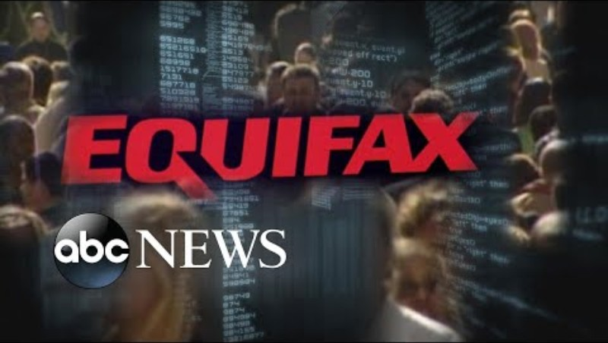
ABC News (2019, July 22). Equifax to pay $700M after massive data breach [Video]. YouTube. https://youtu.be/_c0AoirlQhw?si=sFqwK_P6vT5ONp9l

Slide 56
Regulations in the Real World
Healthcare Regulations
The Health Insurance Portability and Accountability Act (HIPAA) governs medical data security and privacy.
Requires patient information to be stored for at least six years and kept confidential.
Defines procedures for secure billing, data exchange, and patient communication.
Violations include unauthorized disclosure or careless handling of patient records.
Financial Services
The Financial Services Modernization Act (Gramm-Leach-Bliley Act) requires financial institutions to protect customer data.
Data must be stored securely and transmitted through protected channels.
Institutions must establish written policies describing how they guard customer information.

Slide 57
Regulations in the Real World
Public Company Rules
The Sarbanes-Oxley Act was designed to rebuild investor confidence after major corporate scandals.
Requires internal controls to guarantee the accuracy and integrity of financial data.
Information systems must ensure that data used in financial statements are accurate and traceable.
Controls must also prevent unauthorized access and maintain data availability during disruptions.
Privacy and Data-Retention Laws
The General Data Protection Regulation (GDPR) applies to all firms operating within the European Union.
In the United States, privacy laws differ across federal and state levels.
Retaining data longer than legally allowed can violate privacy even if no breach occurs.

Slide 58

U.S. SEC (2022, August 2). What Did the Sarbanes-Oxley Act do? | Office Hours with Gary Gensler [Video]. YouTube. https://youtu.be/eJChWPaOMJo?si=-OZAnz3_u0ud6FpO

Slide 59
Electronic Evidence and Digital Forensics
Electronic Evidence
Most modern legal cases depend on Electronically Stored Information (ESI) such as emails, messages, and social-media posts.
Organizations must produce relevant ESI during litigation when requested by a court.
The cost of discovery rises sharply if data are disorganized or destroyed.
Courts can impose severe penalties for improper deletion or loss of digital evidence.
Digital Forensics
The scientific process of collecting and analyzing ESI for use in legal proceedings.
Key activities include recovering deleted or hidden files from storage devices, preserving evidential integrity while copying data, searching through large data sets for relevant content, and presenting findings clearly to legal authorities
Even deleted files or fragments can often be recovered and authenticated.

Slide 60
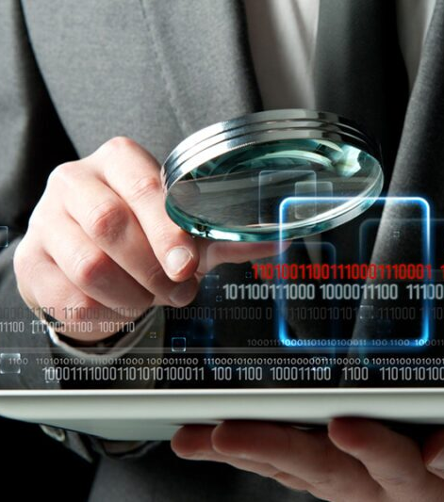
Integrating Forensics into Business Planning
Firms should incorporate digital forensics awareness into contingency and incident-response plans.
The Chief Information Officer (CIO) or Chief Technology Officer (CTO), security staff, and legal counsel must coordinate to ensure readiness for discovery requests.
Effective evidence management reduces legal risk and protects corporate credibility.

Slide 61
Organizational Frameworks
for Security and Control

Slide 62
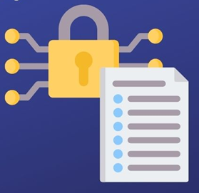
The Need for a Framework
Even the best security tools fail without a clear plan for how and where to use them.
Managers must know which assets are most at risk and what controls protect them.
A strong framework includes policies, risk assessment, system controls, and audit procedures.
Effective planning ensures business continuity and organizational resilience.

Slide 63
Information Systems Controls
General controls apply to all systems and create the overall control environment.
Include software, hardware, operations, data security, and administrative procedures.
Application controls are specific to each system or function, such as payroll or order processing, and ensure that data are authorized, complete, and accurate.
Input controls that check data accuracy when they enter the system
Processing controls that verify data integrity during updates
Output controls that ensure results are correct and properly distributed
Controls must be built into system design and user behavior, not added afterward.

Slide 64
Risk Assessment
Before allocating resources, a firm must identify which assets need protection and how vulnerable they are.
Risk assessment estimates the probability and potential loss from threats to each system.
Managers Evaluate:
The value of each information asset
Likely frequency of failure or abuse
Financial impact of downtime or data loss
Controls should focus on the highest-risk areas with the greatest expected losses.

Slide 65
Security Policy
After you’ve identified the main risks to your systems, your company will need to develop a security policy for protecting the company’s assets.
A security policy defines acceptable levels of risk and the mechanisms for protection.
The policy identifies:
The most valuable assets and who controls them
The acceptable level of risk for each system
The cost of maintaining that level of protection
Policies must be reviewed and updated regularly as technologies and threats evolve.

Slide 66
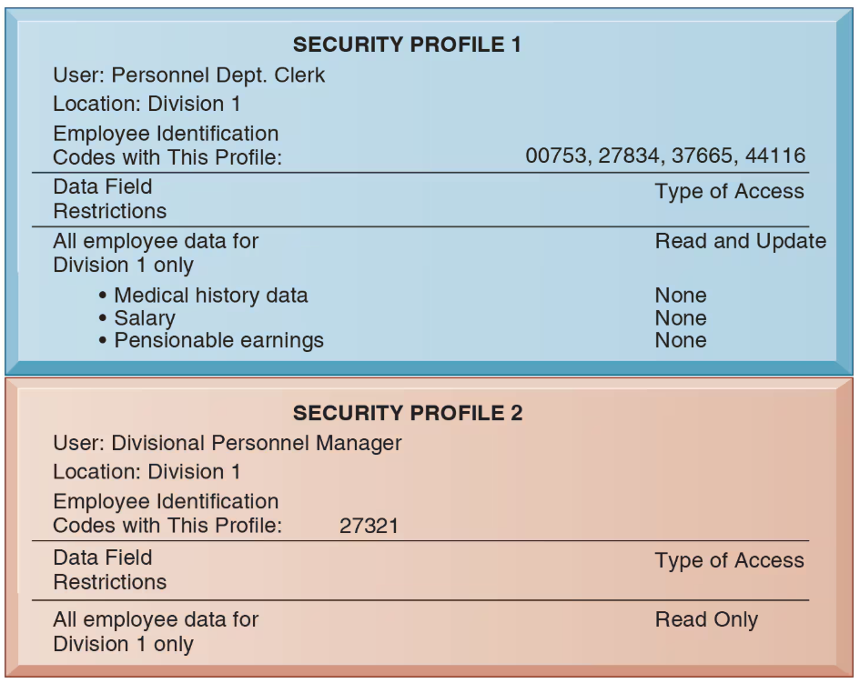
Acceptable Use and Access Controls
An Acceptable Use Policy (AUP) defines appropriate behavior for using company devices and data.
It specifies permitted and prohibited actions and the consequences for violations.
Access controls determine which users can view or modify data based on job roles.
Role-based access control limits exposure to sensitive information.

Slide 67
Disaster Recovery and Business Continuity
Disaster recovery planning focuses on restoring computing and network services after an outage or disaster.
It specifies which files to back up and where backup systems will be located.
Firms may use remote data centers or contract with cloud recovery providers.
Business continuity planning focuses on restoring operations and serving customers after a disruption.
Both plans require collaboration between IT and business managers to identify critical systems and acceptable downtime.

Slide 68
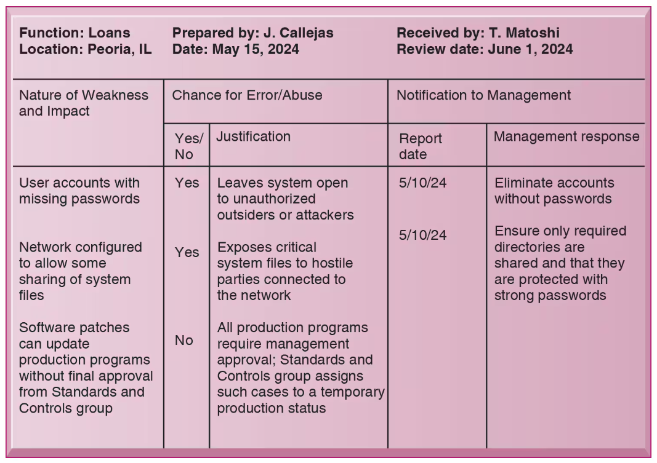
Auditing and Continuous Review
Management must confirm that security and control systems actually work.
An information systems audit examines overall security and the controls in each system.
Auditors trace transactions, test procedures, and evaluate data quality.
Security audits review technology, documentation, and personnel training.
Simulated incidents may be used to test response effectiveness.

Slide 69
Technologies for Safeguarding
Information Resources

Slide 70
Safeguarding Information Resources
Identity and Access Management (IAM)
IAM software assigns each user a digital identity and manages roles and privileges across many systems.
Zero trust means never trust by default, verify every request, and limit access to only what is needed.
Least privilege restricts users to the minimum permissions required for their tasks.
Authentication
Passwords are common, yet often weak and easily shared or phished.
Stronger factors include security tokens, smart cards, and biometric authentication.
AI can analyze behavioral signals such as typing speed or mouse movement to confirm identity.
Multifactor Authentication (MFA)
MFA validates users with two or more independent factors.
Something you know (a password or PIN), something you have (a phone or token), and something you are (a biometric trait)

Slide 71
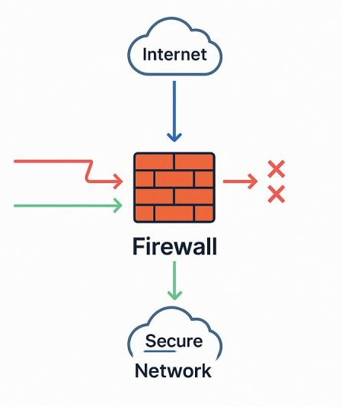
Safeguarding Information Resources
Firewalls
Firewalls block unauthorized traffic between private networks and outside networks.
Can be hardware, software, or a managed service.
Core Techniques:
Packet filtering checks selected header fields
Stateful inspection tracks connection state across packets
Network Address Translation hides internal addresses
Application gateways and proxies inspect application content, with optional web application firewalls for HTTP and HTTPS
Next-generation firewalls identify applications and users, inspect encrypted traffic, and apply real-time threat controls
Good firewalls depend on clear and up to date rules. AI can help analyze traffic and suggest safer rules.

Slide 72
Safeguarding Information Resources
Intrusion Detection (ID) and Prevention (IP)
IDS monitors hot spots in the network and raises alerts on suspicious activity.
IPS adds blocking, for example drops sessions, resets connections, or quarantines devices.
Anti-Malware and Unified Threat Management (UTM)
Anti-malware scans for known signatures and suspicious behavior, requires constant updates, and benefits from AI models that generalize to new threats.
UTM systems combine multiple tools in one platform, for example firewall, VPN, IDS and IPS, web filtering, and anti-spam, to simplify management.
Securing Wireless Networks
WEP is weak and no longer acceptable.
WPA2 and WPA3 use stronger, rotating keys, yet still require careful setup.
Pair Wi-Fi access with VPN when reaching internal resources from public or semi-public spaces.

Slide 73
Safeguarding Information Resources
Encryption and Public Key Infrastructure (PKI)
Encryption transforms plain data into cipher text that only intended parties can read.
Web traffic uses TLS and HTTPS, often with HSTS to force secure sessions.
Public key encryption uses a matched public key and private key.
Digital certificates and a certificate authority bind public keys to identities.
PKI supports secure e-commerce and authenticated exchanges.
Future risk, rapid progress in quantum computing and AI may weaken current crypto, plan for post-quantum methods.
Blockchain
A blockchain records transactions in linked blocks, which makes changes easy to detect.
Each participant signs with a private key, and altered records fail validation.
Blockchain still needs strong governance, access controls, and secure endpoints.

Slide 74
Safeguarding Information Resources
Ensuring System Availability
Fault-tolerant systems include redundancy, so service continues during failures.
Self-checking logic detects faults and shifts to backups without downtime.
Monitor and minimize downtime, since unplanned outages create direct financial losses.
Security Operations Centers and Outsourcing
A SOC monitors the full environment continuously, detects incidents, and coordinates response.
AI can correlate logs, prioritize alerts, and recommend patches.
Managed security service providers offer SOC capabilities to firms that lack in-house resources.
Digital Resiliency
Resiliency extends beyond IT components to policies, culture, and processes.
Cloud services, third parties, and mobile access increase complexity and risk.
Design, measure, and test resiliency, then remove single points of failure.

Slide 75
New Challenges
IoT Security Challenges
Many IoT devices have simple chips and limited operating systems, which limits security options.
Protect devices against tampering, encrypt communications, and account for battery-drain attacks.
Maintain inventories, isolate device networks, and apply firmware updates quickly.
Cloud Security Challenges
Shared responsibility depends on the service model
PaaS and SaaS shift some duties to the provider, yet customers still own data protection and access control.
Best practices:
Continuous audits with real-time visibility, Zero trust with least privilege between data center and cloud, Unified security management across environments, AI and automation for detection and response, external audits, and compliance with location and privacy rules.

Slide 76
New Challenges
Mobile Platform Security
Extend corporate policy to phones and tablets.
Use mobile device management for enrollment, inventory, updates, remote lock, and remote wipe.
Apply data loss prevention to watch where sensitive data moves.
Approve platform versions and apps, encrypt traffic, and require strong device security features.
Ensuring Software Quality
Use software metrics to measure throughput, response time, and defect rates.
Test early and often.
Walkthroughs review design before coding begins.
Unit tests, integration tests, and system tests uncover defects, and debugging removes them.
Track issues and fixes so reliability improves over time.

Slide 77
Recap of Chapter 8

Slide 78
Recap of Chapter 8
Understand why information systems are vulnerable.
Describe the most prevalent and dangerous types of malware.
Understand the dangers posed by threat actors.
Describe the security issues raised by software vulnerabilities.
Describe the security issues raised by artificial intelligence.
Describe the business value of security and control.
Describe an organizational framework for security and control.
Discuss technologies for safeguarding information resources.

